Slide 1
POLYMER PRODUCTS
Technical Presentation for Source Approval – Elastomeric Bearings
Proposed Bearing Vendor – BMC / Coastal Road Project North

Slide 2
Presentation Agenda
• Company profile and experience
• Elastomeric bearing product and application
• Applicable standards and approvals
• Manufacturing process and materials
• Plant, machinery and testing facilities
• Quality assurance / quality control system
• Traceability, inspection and testing
• Major project experience and client credentials
• Storage, transportation and installation
POLYMER PRODUCTS | Technical Presentation | 2

Slide 3
Company Profile
Company at a Glance
Group & Technical Background
• Polymer Products is presented as a bridge-bearing supplier in the civil engineering industry.
• Elastomeric bearings are manufactured at the Nashik manufacturing and testing facility.
• Operations are managed by an experienced Rubber Technologist with engineers, chemists and supervisory staff.
• The credential document describes more than three decades of elastomeric bearing and seismic pad supply experience.
• Dynamic Group is described as a 45-year-old established Indian company.
• Experience includes design, manufacturing, supply and installation of Elastomeric and POT-PTFE bridge bearings.
• Supplies have included Indian Railways, National Highways, PWDs, Metros and irrigation projects.
• The document states supply in accordance with Indian and international standards.
POLYMER PRODUCTS | Technical Presentation | 3

Slide 4
Locations & Contact
Corporate Office
Works / Manufacturing Facility
• 72, Mahavir Centre, Sector-17, Vashi, Navi Mumbai – 400 705
• Tel.: (022) 27892628 / 27891310
• Email: polymerproducts09@gmail.com
• Email: polymerproduct@rediffmail.com
• Website shown in credential: dynamicprestress.com
• H-32, M.I.D.C., Satpur, Nashik – 422 007
• Telefax: (0253) 2350935, 6604461
• Manufacturing and testing of elastomeric bearings
• Facility supported by in-house testing equipment
• Testing is described as being carried out in presence of client / inspecting representatives where applicable.
POLYMER PRODUCTS | Technical Presentation | 4

Slide 5
Product: Elastomeric / Neoprene Bearings
Primary Function
Bearing Characteristics
• Accommodate expansion and contraction caused by temperature and humidity changes.
• Accommodate relative movement between superstructure and supporting structure.
• Transfer vertical load and associated forces to piers / columns.
• Provide the designed degree of freedom for bridge movements.
• Strong while retaining flexibility.
• Weather resistant as described in the company material.
• Economical design with no moving parts.
• Low shear stiffness can reduce horizontal force transfer to the substructure.
• Durable / maintenance-free characteristics are stated in the company brochure.
POLYMER PRODUCTS | Technical Presentation | 5

Slide 6
Bearing Construction & Materials
• Elastomeric bridge bearings consist of layers of rubber compound integrally bonded to steel plates.
• The rubber compound is described as a designed mix of chloroprene rubber, carbon black, plasticisers, curatives, antidegradants and accelerators.
• Steel plates are cleaned / treated and shot-blasted to prepare the surface for bonding.
• Required bearing shape and dimensions are obtained during the vulcanization process.
• The credential states that raw materials and their ratios are controlled from mixing through final moulding.
POLYMER PRODUCTS | Technical Presentation | 6

Slide 7
Applicable Standards & Approvals
Approvals / Qualifications in Credential
Standards Referenced
• MORTH – pre-qualification / approval for Elastomeric (Neoprene) bearings is stated.
• RDSO – approval for supply of Elastomeric bearings is stated.
• RDSO letter dated 06.04.2023 confirms continuation in the RDSO approved list after compliance of revised STR and physical verification.
• ISO and CE certificates are included in the credential package.
• IRC specifications are referenced in the Quality Assurance Plan.
• IRC:83 Part (II) – 2018 is repeatedly referenced in the QAP for rubber, steel and finished bearing tests.
• The company brochure states bearings are moulded to conform to applicable MORTH, IRC and DIC requirements.
• Project-specific specifications and approved drawings should govern each order.
POLYMER PRODUCTS | Technical Presentation | 7

Slide 8
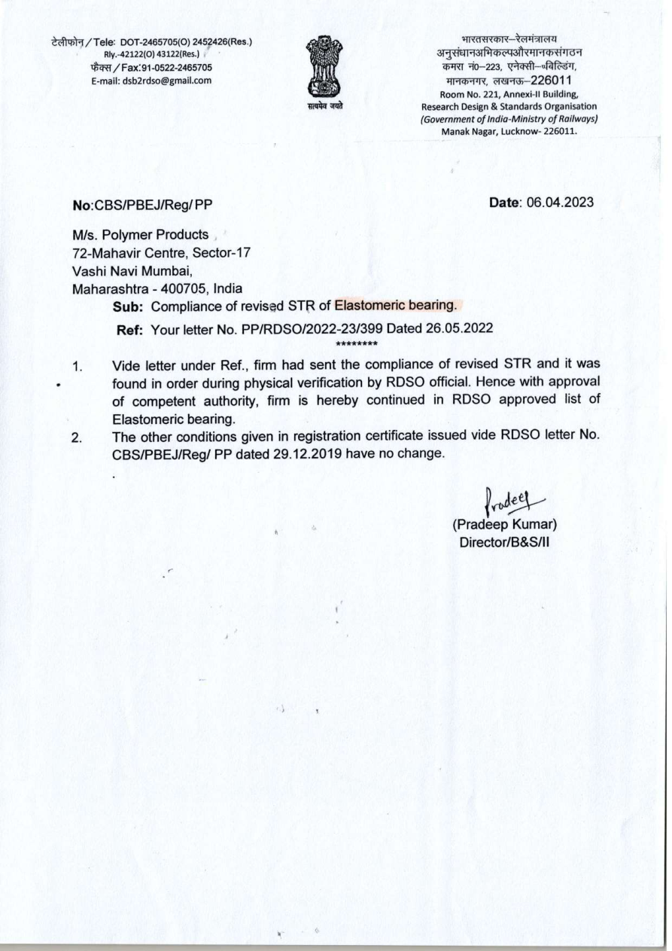
RDSO Approval – Credential Evidence
POLYMER PRODUCTS | Technical Presentation | 8

Slide 9
Manufacturing Process – Controlled Sequence
1
Raw material scrutiny
2
Rubber compound mixing
3
Compound testing / batch control
4
Steel plate preparation & shot blasting
5
Bonding / assembly
6
Moulding & vulcanization
7
Finishing & dimensional inspection
8
Finished bearing testing
9
Identification / traceability
10
Packing & controlled dispatch
POLYMER PRODUCTS | Technical Presentation | 9

Slide 10
Manufacturing Capacity & Plant Facilities
Presses / Manufacturing Equipment
Process Equipment
• Hydraulic manufacturing presses listed with capacities from 110 Tons to 300 Tons.
• Additional 180-Ton presses are listed in the equipment schedule.
• 750-Ton hydraulic test press with 42 × 42 inch test bed is listed.
• 300-Ton, 250-Ton, 200-Ton, 180-Ton and 110-Ton presses are listed for bearing manufacture.
• Rubber mixing mill
• Shot blasting / abrasive blasting equipment
• Surface grinder
• Bandsaw machine
• Welding machine
• Moulding and vulcanization equipment
• The document states additional moulding machinery and press capacity were added to enhance production capacity.
POLYMER PRODUCTS | Technical Presentation | 10

Slide 11
Testing Laboratory – Major Equipment
• 750-Ton hydraulic press – elastic modulus, shear modulus on large-size bearings and ultimate compression.
• Hydraulic jack – shear modulus testing on large-size bearings.
• 80-Ton hydraulic jack – bond test.
• 5,000 N tensile tester – tensile strength, elongation, tear strength and rubber-to-metal adhesion.
• Oscillating Disc Rheometer – curing characteristics / batch-to-batch rubber compound control.
• Oven – ageing and compression testing.
• Hardness testers – hardness measurement.
• Digital balance – chemical analysis, ash content and specific gravity.
• Muffle furnace / Soxhlet apparatus – ash and elastomer content.
• Thickness gauge and other supporting laboratory equipment.
POLYMER PRODUCTS | Technical Presentation | 11

Slide 12
Quality Assurance Plan – Raw Materials
Rubber Component – Per Lot
M.S. Plate – Procurement Lot
• Tensile strength
• Percentage elongation
• Hardness
• Adhesion strength
• 01 sample per lot is shown in the QAP.
• Reference: IRC:83 Part (II) – 2018.
• Testing agency: Manufacturer's Laboratory.
• Tensile strength
• Percentage elongation
• One piece per procurement lot is shown in the QAP.
• Reference: IRC:83 Part (II) – 2018.
• Testing agency: Independent Laboratory.
• Acceptance criteria are linked to the referenced specification.
POLYMER PRODUCTS | Technical Presentation | 12

Slide 13
Quality Assurance Plan – Finished Bearings
Routine / Finished Bearing Checks
Additional Tests in QAP
• Visual inspection
• Dimension check
• Hardness
• Elastic modulus check
• Shear modulus test
• Stripping strength test
• Ultimate compressive test
• Rubber compression test – one sample per lot.
• Rubber ageing test – one sample per lot.
• Axial load testing at 5 MPa and 15 MPa is listed for finished bearings.
• The QAP references IRC:83 Part (II) – 2018.
• Manufacturer's laboratory is listed for the finished-bearing tests.
POLYMER PRODUCTS | Technical Presentation | 13

Slide 14
Testing Philosophy & Finished Product Verification
• The credential states that essential tests are conducted at both raw-material and finished-product stages.
• Testing is described as being conducted in line with applicable IRC / DIC specifications.
• Finished bearing tests listed in the brochure include vertical stress/strain curve, shear modulus, ultimate compression strength and rubber-to-metal bond verification.
• Testing is performed under the guidance of a Rubber Technologist by experienced personnel.
• The equipment schedule states testing can be witnessed by DGS&D / RITES / client representatives where applicable.
POLYMER PRODUCTS | Technical Presentation | 14

Slide 15
Traceability, Identification & Quality Records
• Lot-wise control is established through raw-material and compound testing records.
• The QAP defines sample frequency, test methods / reference documents, acceptance criteria and testing agency.
• Finished bearing inspection includes visual and dimensional checks before release.
• Test results should be linked to the bearing / order identification used for dispatch documentation.
• For BMC source approval, the project-specific marking and traceability format should be finalized with the approved QAP / ITP.
POLYMER PRODUCTS | Technical Presentation | 15

Slide 16
Project Experience – Selected Credentials
Rail / Metro / Highway Experience Mentioned
Representative Client List
• Konkan Railways
• MTP Railways
• NHAI projects
• MSRDC flyovers
• Railway ROBs
• CPWD & PWD flyovers
• Bangalore Metro Rail Corporation project
• Larsen & Toubro Ltd.
• Dilip Buildcon Ltd.
• Afcons Infrastructure Ltd.
• Ashoka Buildcon Pvt. Ltd.
• Supreme Infrastructure India Ltd.
• ITD Cementation India Ltd.
• UP State Bridge Corporation Ltd.
• Bihar Pul Nirman Nigam Ltd.
POLYMER PRODUCTS | Technical Presentation | 16

Slide 17
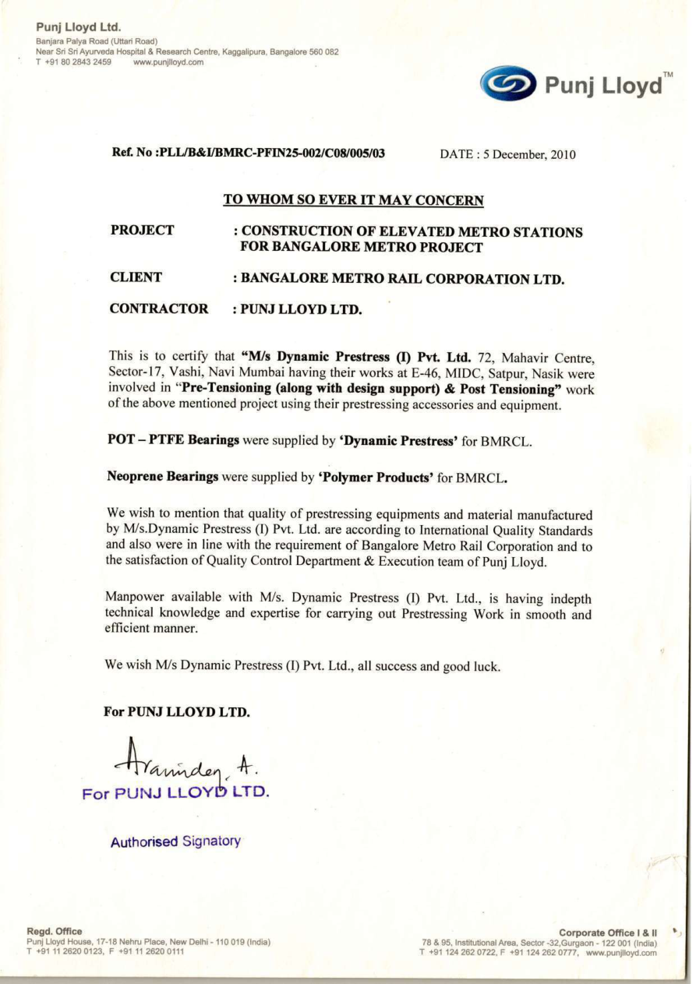
Project Credential – Bangalore Metro
POLYMER PRODUCTS | Technical Presentation | 17

Slide 18
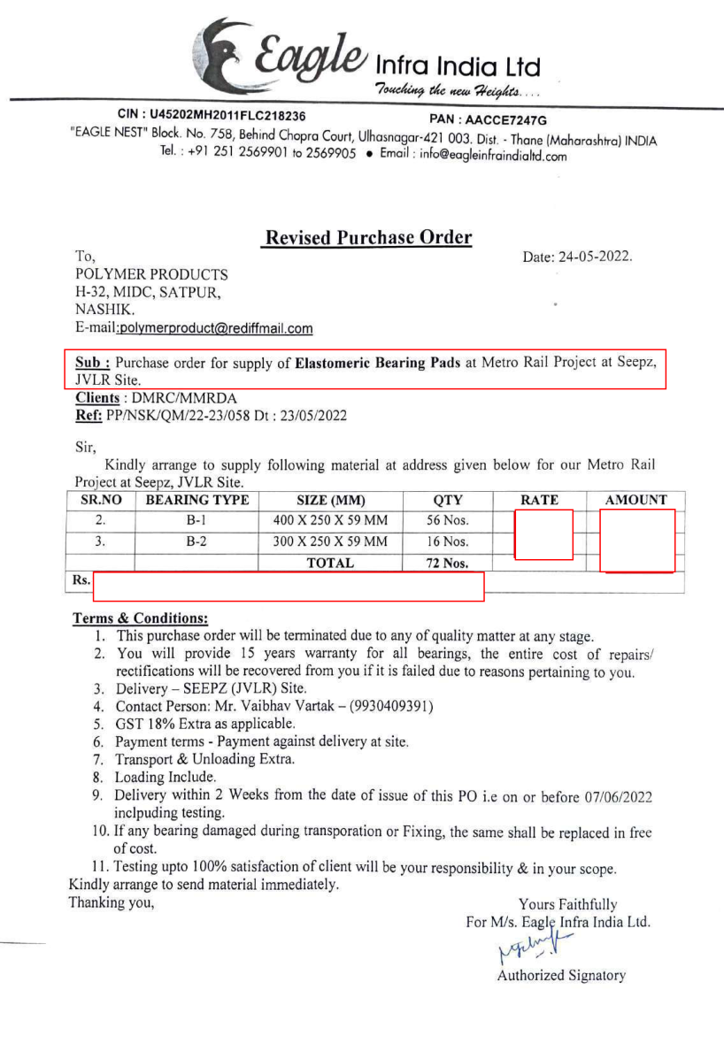
Project Credential – Metro Rail Supply
POLYMER PRODUCTS | Technical Presentation | 18

Slide 19
Storage, Handling & Transportation
Storage / Handling
Transportation / Site Receipt
• Bearings should be protected from contamination with oil, grease and dirt.
• Store and handle bearings carefully to prevent mechanical damage.
• Maintain proper orientation and avoid impact / deformation during handling.
• Protect finished bearing surfaces and identification markings.
• Bearings are stated to be packed and transported with care to avoid mechanical damage.
• Inspect packaging and bearing condition on receipt.
• Record any transit damage before installation.
• Follow project-approved installation procedure and tolerances.
POLYMER PRODUCTS | Technical Presentation | 19

Slide 20
Installation of Elastomeric Bearings
• Bearing installation is described as simple, but proper fixing is essential.
• Bearings must be placed between true horizontal surfaces within the tolerances specified in the applicable code.
• The company brochure specifically refers to following IRC-83 (Part-II) installation requirements.
• For cast-in-place concrete, precast concrete or steel superstructure, the relevant approved installation procedure should be followed.
• Site cleanliness, correct positioning, level / alignment and protection from contamination are critical.
POLYMER PRODUCTS | Technical Presentation | 20

Slide 21
Why Polymer Products – Technical Capability
• Dedicated elastomeric bearing manufacturing and testing facility at Nashik.
• Long-standing experience in bridge and infrastructure bearing supply.
• RDSO approval / continuation documented in the credential package.
• MORTH approval / pre-qualification stated in the company material.
• In-house rubber and finished-bearing testing facilities.
• Documented Quality Assurance Plan with raw-material, in-process and finished-product controls.
• Experience across rail, road, metro, ROB, flyover and other infrastructure applications.
POLYMER PRODUCTS | Technical Presentation | 21

Slide 22
BMC Presentation – Key Commitments
• Manufacture bearings strictly against approved drawings, specifications and applicable codes.
• Maintain controlled raw-material and compound quality.
• Conduct defined inspection and testing before dispatch.
• Maintain lot-wise documentation and product traceability.
• Provide required test certificates and quality records.
• Coordinate with BMC / PMC / Contractor QA/QC representatives for inspection and testing.
• Ensure proper packing, transportation and site-handling guidance.
POLYMER PRODUCTS | Technical Presentation | 22

Slide 23
Closing
Thank You
POLYMER PRODUCTS
Manufacturer of Elastomeric Bearings
Vashi, Navi Mumbai | Manufacturing Works: Satpur, Nashik
POLYMER PRODUCTS | Technical Presentation | 23

